Slide 1
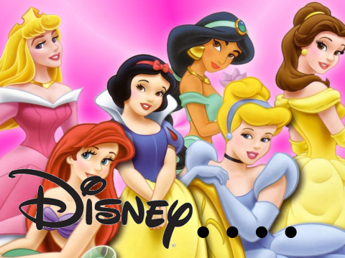
Which is your favourite disney film?

Slide 2
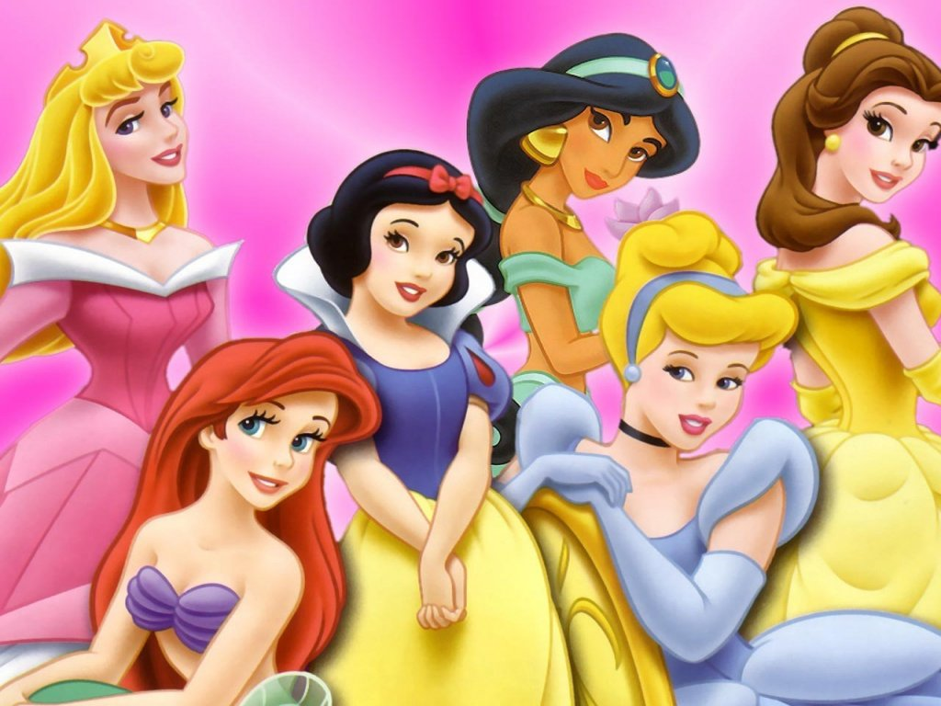
......

Slide 3
Learning objectives
All: Will be about to define gender stereotyping’
Most: Will be able to identify gender stereotyping within the plots of well known Disney films
Some: Will analyse what needs to change in these characters in order for them to be a good role model for young people

Slide 4
......

Slide 5
Men, women and disney
http://www.youtube.com/watch?v=8CWMCt35oFY

Slide 6
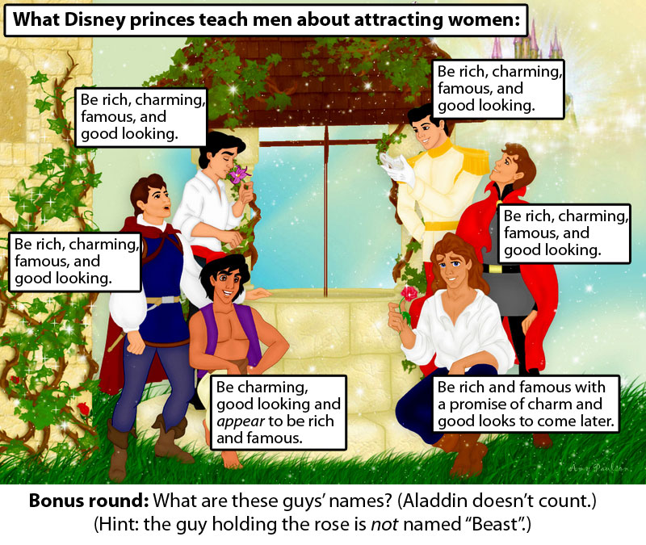

Slide 7
Andy Gray and Richard keys
Sky Sports presenters Andy Gray and Richard Keys have been accused of sexism after making several comments about a female linesman (or should that be lines person?!), called Sian Massey. They commented on her understanding of the offside rule during a Premier League match. The commentators believed their microphones were switched off but were actually recorded making remarks such as:
‘Somebody better get down there and explain offside to her.’
‘Can you believe that? A female linesman. Women don’t know the offside rule.’

Slide 8
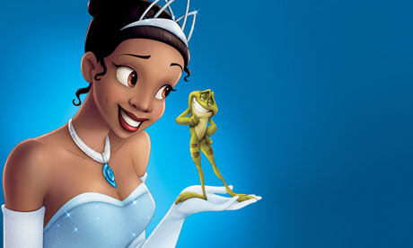
Racism and Disney
Black feminists think that the Princess and the Frog is an awful film because they have given the main character a white
Woman’s face and just used a different colour to fill in the drawing.

Slide 9
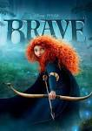
Design a Disney Prince/ Princess to be proud of!
They have to be independent
Have to be fighting against some kind
of gender stereotype
Have a healthy body
Has a functional relationship or is SINGLE
Has an education
Isn’t getting married at 16 and have no further goals

